Slide 1
demo tab
File created on: Wed, 17/12/2025 20:39:51

Slide 2


Slide 3


Slide 4


Slide 5
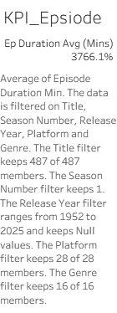

Slide 6


Slide 7
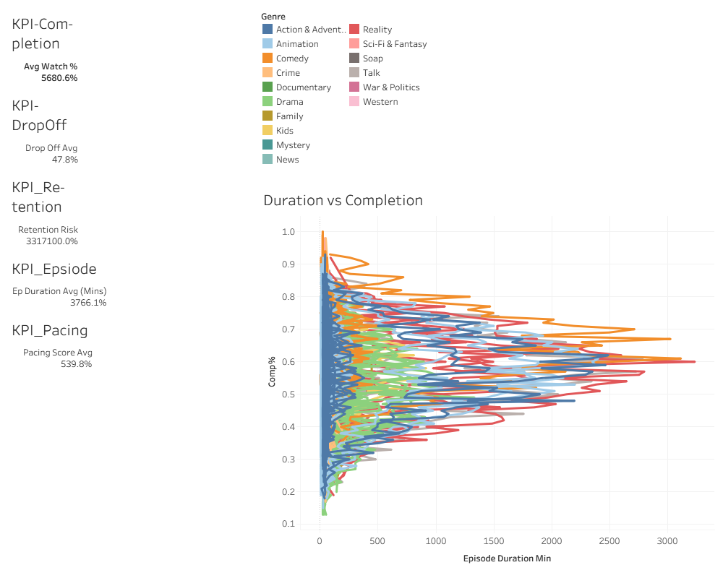

Slide 8


Slide 9


Slide 10
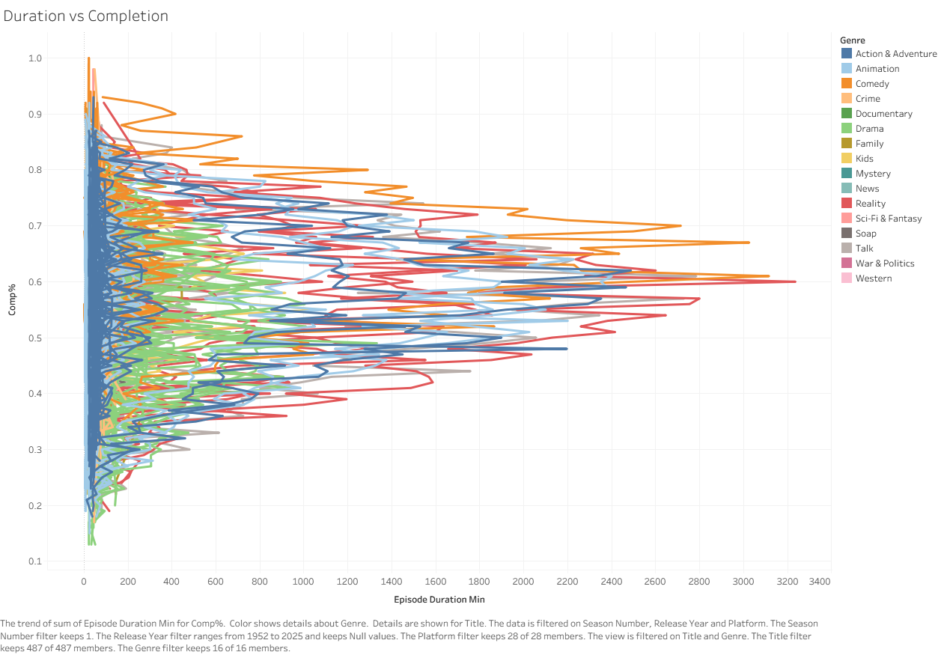

Slide 11
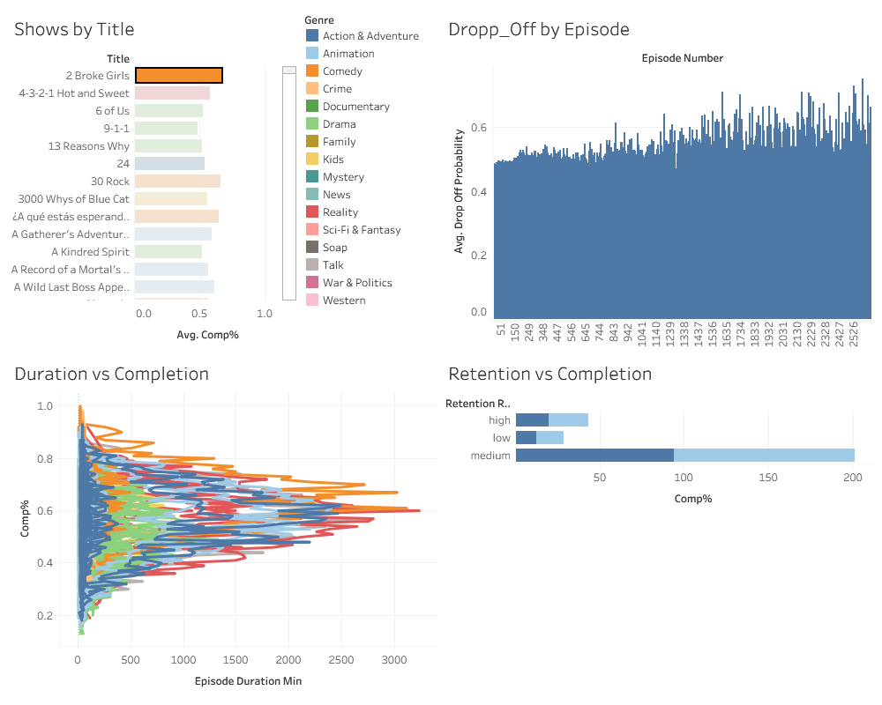

Slide 13


